Slide 1
File Directory Application
Developed by Avinash Rao

Slide 2
Approach and Design
Created abstract Entry.java class to act as the base object type for FileEntry.java and FolderEntry.java objects
Created FileEntry.java and FolderEntry.java child classes that extend Entry.java
The program uses ArrayLists of type Entry so that both Folders and Files can exist within the same ArrayList
DirectoryApp.java allows the user to use ls, cd, and size as required, as well as other methods
This application creates real files that are stored in memory and can be modified at any time

Slide 3
Approach and Design (2)
User-callable Functions
cd <folderName> - changes the directory | cd .. - changes directory to original parent folder
ls - list content in current directory
mkdir <folderName> - creates a new folder | touch <fileName> - creates a new file
write <fileName> <text> appends text to an existing file
size - recursively calculates total size of current and subdirectories in bytes
exit - quit program

Slide 4
Key Files and Folders
On the github repository, there are just two files, Entry.java and DirectoryApp.java
DirectoryApp.java contains the main method
Both should be downloaded to run the program
The README.md contains information that is already stated in this presentation

Slide 5
Running the App
Download the files
Move them into a new Java Project in the IDE of your choice, under the same package
Use the README or this presentation to understand how the user methods work
Run the DirectoryApp.java file, since it contains main method
App should immediately run and should be ready to run user methods

Slide 6
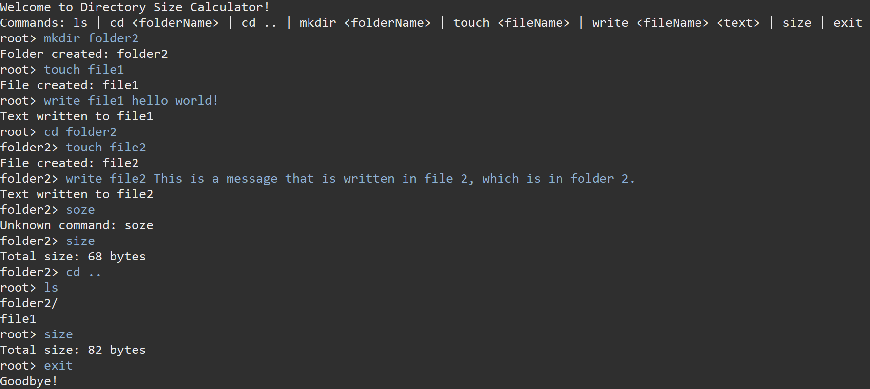
Sample Output

